Slide 1

Difficulty and Way Forward
Franck Cappello
Argonne National Laboratory
Notes:
Thanks for the introduction
Thanks to the organizers for the invitation to give a keynote
Of course, I would like also to thank all the collaborators and students, postdocs and researchers who collaborated with me.
Don’t count, there are more than 450 ;-)
You know it already; it is extremely hard to succeed alone in research. So, I took the easy way: I collaborated with many talented researchers.
I would like to thank all of them for sharing some of their time and for all the discussions we had.

Slide 2
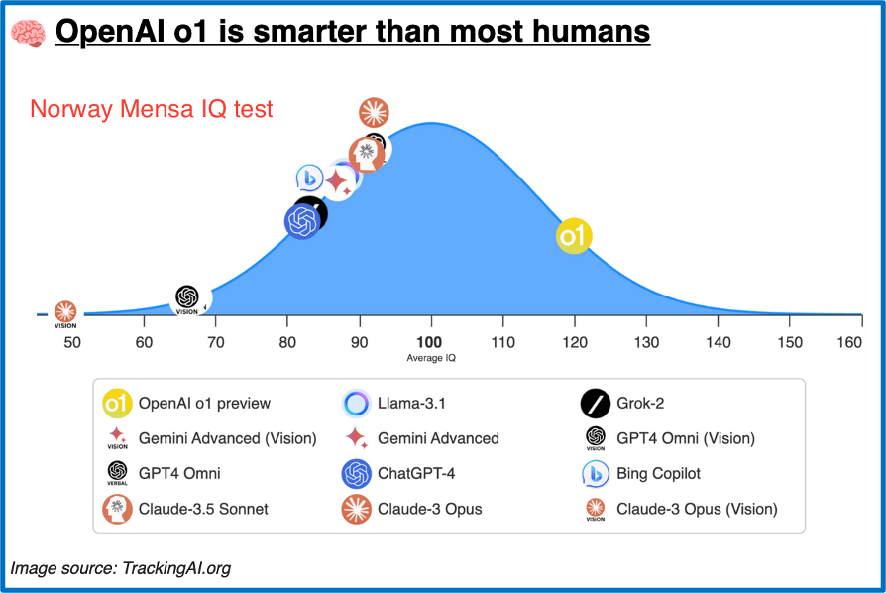
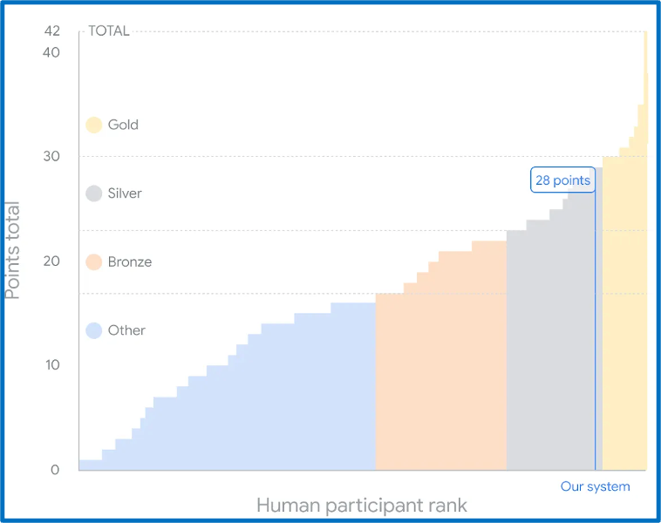
Why difficulty matters?
OpenAI O1 obtained 78% accuracy on GPQA
diamond (Exceed human scholars on this benchmark: <70%)
Google AlphaProof and AphaGeometry 2 reach silver medal level on International Mathematics Olympiad

Slide 3
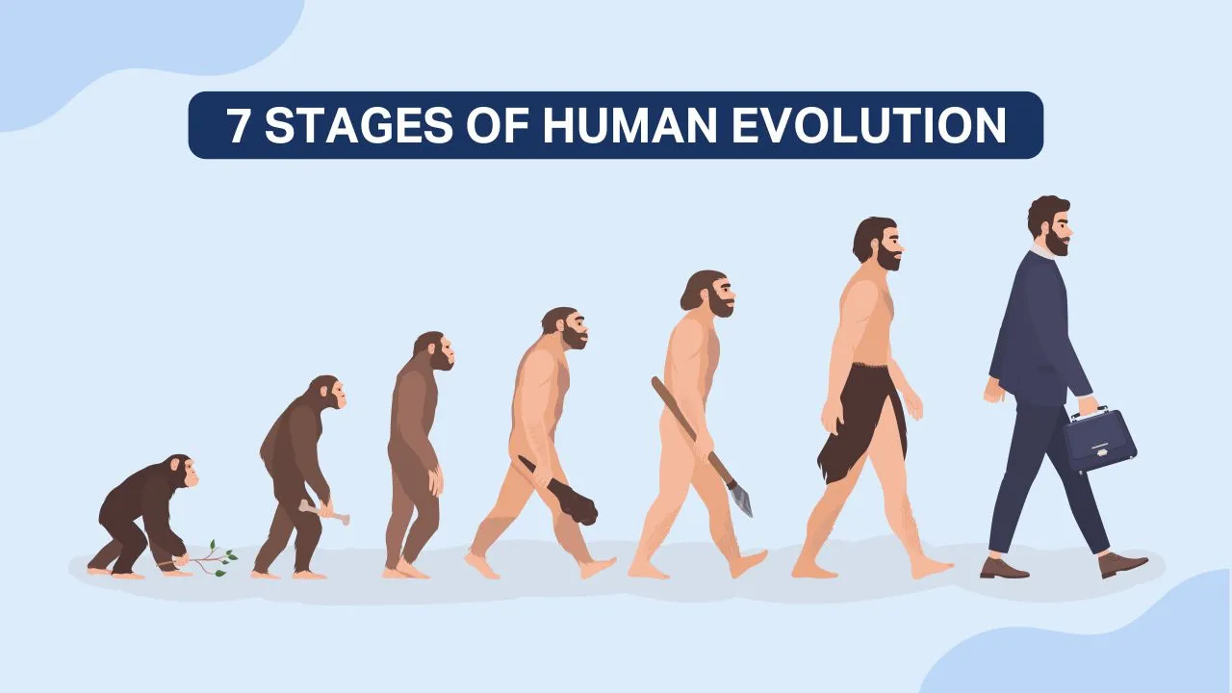
Why difficulty matters?
IQ: 100
How we Eval
this stage?
Stages of AI Evolution
IQ: 120
O1 on GPQA Diamond: 78%
Llama 3 70B Inst.: ~40% (Dia?)
ChatGPT
Claude
Llama
O1
NN

Slide 4
Difficulty and way forward
Benchmarks have more or less questions (up to 1M, if automatically generate). But how “difficult” are they? What are the distributions of “difficulties” in these benchmarks?
When developing a benchmark we target a vague “difficulty” level: should be undergraduate or graduate level (GPQA).
We also define “difficulty” (for MCQ, Open-ended) empirically based on model performance:
The model does not respond well: the question must be too difficult (what does this mean?)
The model responds correctly to most questions of a benchmark: the questions must not be difficult enough.
So the first question is how we define “difficulty” in a more granular/scientific way?
→ what are the “difficulty” criteria/parameters? → how can we construct tests/questions with a specified level of “difficulty”?
It’s important to know what’s in our current benchmarks
It’s important to develop new benchmark rigorously
It’s critical for the way forward: how to create questions difficult enough for O1 and the next gen.

Slide 5
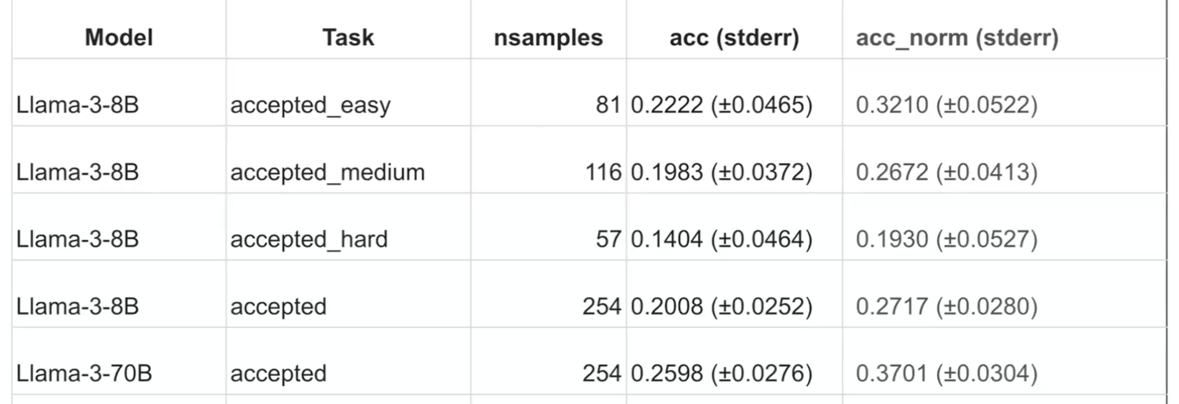
People have a good sense of “difficulty”
AI4S benchmark:
So, let’s dig a little bit and define “difficulty”

Slide 6
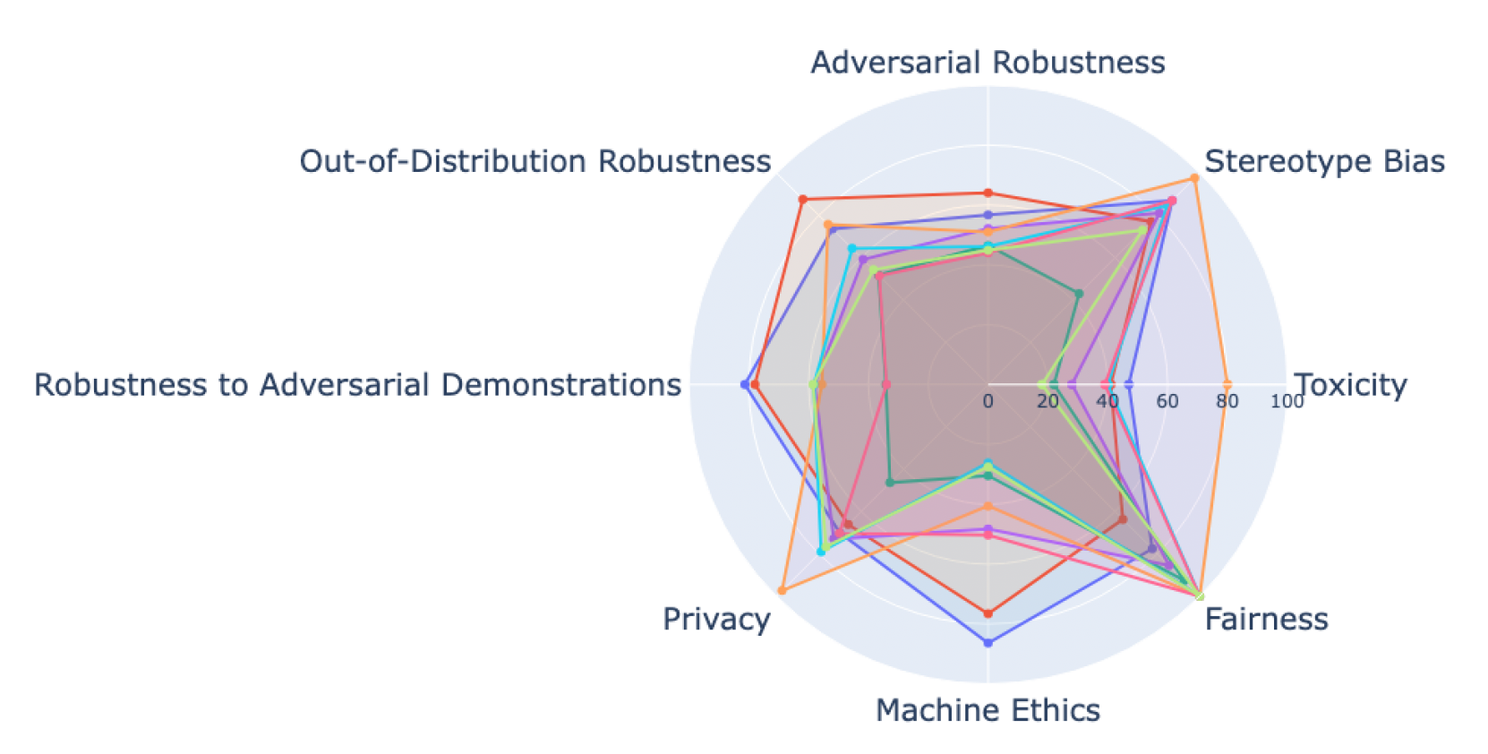
Shall we develop “skill” focused tests?
Follow DecodingTrust direction?
Testing skills separately / defining specific difficulty parameters for each?

Slide 7
Bloom Taxonomy: 2001 version
A tiered system of classifying thinking skills according to six cognitive levels of complexity (hierarchical 1 to 6)
The revised taxonomy introduces changes to better reflect the active and dynamic nature of learning:
Remember (Recall)
Definition: Retrieving relevant knowledge from long-term memory.
Examples: Recognizing, recalling, listing.
Understand (Classify, Summarize, Explain)
Definition: Constructing meaning from instructional messages.
Examples: Interpreting, summarizing, classifying, explaining.
Apply (Execute workflow, Perform tasks, Delegate to tools)
Definition: Carrying out or using procedures in new situations.
Examples: Executing, implementing, using.
Analyze (Decompose, Label, Associate)
Definition: Breaking material into parts and determining how they relate to one another and to an overall structure.
Examples: Differentiating, organizing, attributing.
Evaluate (Compare, measure, ?)
Definition: Making judgments based on criteria and standards.
Examples: Checking, critiquing, assessing.
Create (Generate Hypothesis, Plan)
Definition: Putting elements together to form a novel, coherent whole or making an original product.
Examples: Generating, planning, producing, designing.

Slide 8
Bloom: What LLMs are capable of today?
A tiered system of classifying thinking skills according to six cognitive levels of complexity (hierarchical 1 to 6)
The revised taxonomy introduces changes to better reflect the active and dynamic nature of learning:
Remember (Recall)
Definition: Retrieving relevant knowledge from long-term memory.
Examples: Recognizing, recalling, listing.
Understand (Classify, Summarize, Explain)
Definition: Constructing meaning from instructional messages.
Examples: Interpreting, summarizing, classifying, explaining.
Apply (Execute workflow, Perform tasks, Delegate to tools)
Definition: Carrying out or using procedures in new situations.
Examples: Executing, implementing, using.
Analyze (Decompose, Label, Associate)
Definition: Breaking material into parts and determining how they relate to one another and to an overall structure.
Examples: Differentiating, organizing, attributing.
Evaluate (Compare, measure, ?)
Definition: Making judgments based on criteria and standards.
Examples: Checking, critiquing, assessing.
Create (Generate Hypothesis, Plan)
Definition: Putting elements together to form a novel, coherent whole or making an original product.
Examples: Generating, planning, producing, designing.

Slide 9
How O1 defines “difficulty” of a question
Complexity of Concepts: Questions that involve advanced or abstract concepts requiring deep understanding can be more difficult. For example, solving a calculus problem involving multiple integrals is more complex than a basic arithmetic question.
Cognitive Demand: Higher-order thinking skills—such as analysis, synthesis, and evaluation—make questions more challenging. Bloom's Taxonomy categorizes these skills and helps in understanding the cognitive demand required.
Prior Knowledge Requirements: If a question assumes knowledge of certain facts, theories, or methodologies that the individual lacks, it becomes more difficult.
Ambiguity and Clarity: Questions that are poorly worded, ambiguous, or contain confusing syntax can increase difficulty because they require additional effort to interpret.
Problem-Solving Steps Required: Multi-step problems that require a sequence of operations or the application of multiple concepts
Time Constraints: Limited time to answer a question can increase its difficulty by adding pressure, which may hinder cognitive processing.
Familiarity and Context: Questions set in an unfamiliar context or those that require application of knowledge in a new way can be more challenging.
Distraction Elements: The inclusion of irrelevant information or distractors can complicate the problem-solving process, making the question more difficult.
Language and Terminology: The use of complex language, specialized jargon, or unfamiliar terminology can increase difficulty, Emotional and Psychological Factors: Anxiety, lack of confidence, or stress can make a question seem more difficult, affecting performance.
Interdisciplinary Requirements: Questions that require integrating knowledge from different fields.
Novelty and Originality: Unique or novel problems that the individual has not encountered before.
Open-Endedness: Questions that allow for multiple correct answers or require critical thinking to form an argument or opinion.
Cultural and Contextual Biases: Questions that assume certain cultural knowledge or perspectives can be more difficult for individuals from different backgrounds.
Complex Instructions: Multi-layered instructions or conditional requirements within a question can increase its complexity.

Slide 10
What O1 “difficulty” should we consider?
Complexity of Concepts: Questions that involve advanced or abstract concepts requiring deep understanding can be more difficult. For example, solving a calculus problem involving multiple integrals is more complex than a basic arithmetic question.
Cognitive Demand: Higher-order thinking skills—such as analysis, synthesis, and evaluation—make questions more challenging.
Bloom's Taxonomy categorizes these skills and helps in understanding the cognitive demand required.
Prior Knowledge Requirements: If a question assumes knowledge of certain facts, theories, or methodologies that the individual lacks, it becomes more difficult.
Ambiguity and Clarity: Questions that are poorly worded, ambiguous, or contain confusing syntax can increase difficulty because they require additional effort to interpret.
Problem-Solving Steps Required: Multi-step problems that require a sequence of operations or the application of multiple concepts
Time Constraints/computation complexity: Limited time to answer a question can increase its difficulty by adding pressure, which may hinder cognitive processing.
Familiarity and Context: Questions set in an unfamiliar context or those that require application of knowledge in a new way can be more challenging.
Distraction (confusing) Elements: The inclusion of irrelevant information or distractors can complicate the problem-solving process, making the question more difficult.
Language and Terminology: The use of complex language, specialized jargon, or unfamiliar terminology can increase difficulty,
Emotional and Psychological Factors: Anxiety, lack of confidence, or stress can make a question seem more difficult, affecting performance.
Interdisciplinary Requirements: Questions that require integrating knowledge from different fields.
Novelty and Originality: Unique or novel problems that the individual has not encountered before.
Open-Endedness (terminilogy, Ambiguity and Clarity,Cultural and Contextual Biases): Questions that allow for multiple correct answers or require critical thinking to form an argument or opinion.
Cultural and Contextual Biases: Questions that assume certain cultural knowledge or perspectives can be more difficult for individuals from different backgrounds.
Complex Instructions: Multi-layered instructions or conditional requirements within a question can increase its complexity.

Slide 11
How O1 would generate increasingly difficult questions
Establish a Baseline with Simple Questions
Begin with Basics: Start by assessing foundational knowledge to ensure learners have the necessary groundwork.
Example: In a geography class, begin by asking, "What is the capital of France?"
Incrementally Increase Conceptual Complexity → How we do that incrementally (what is conceptual complexity)?
Introduce Advanced Concepts: Gradually incorporate more complex ideas that build on earlier material.
Example: Progress to "Explain how France's geography has influenced its economic development."
Elevate Cognitive Demand → How we do that incrementally?
Engage Higher-Order Thinking: Shift from recall to application, analysis, synthesis, and evaluation.
Example: Ask, "Evaluate the impact of the European Union on France's national policies."
Add Multi-Step Problem Solving → How we do that incrementally?
Complex Procedures: Require multiple operations or sequential reasoning to arrive at an answer.
Example: In math, move from solving a single equation to tackling a system of equations.
Incorporate Ambiguity and Open-Endedness
Less Defined Parameters: Present scenarios that require interpretation or have multiple valid answers.
Example: Pose, "What strategies could France adopt to address climate change, and what might be the potential impacts?"
Reduce Scaffolding and Guidance → Reduce prompt engineering, reduce number of prompts?
Encourage Independence: Gradually remove hints and supports provided in earlier questions.
Example: From providing a formula to solve a physics problem, progress to asking students to derive the formula themselves.

Slide 12
How O1 would generate increasingly difficult questions
Introduce Novel Contexts and Applications → Ask out of distribution questions (but how to do it incrementally?)
Unfamiliar Situations: Challenge learners to apply knowledge in new or hypothetical scenarios.
Example: "How would France's economy be affected if it were geographically isolated from the rest of Europe?"
Integrate Interdisciplinary Elements → Ask questions requiring knowledge in multiple scientific domains (but how to do it incrementally?)
Cross-Subject Challenges: Combine concepts from different fields to solve a problem.
Example: "Analyze the cultural impact of French art on global society using principles from sociology and history."
Increase Prior Knowledge Requirements → Same as Reduce Scaffolding and Guidance → Reduce prompt engineering, reduce number of prompts?
Assumed Understanding: Expect familiarity with previous material without explicit reminders.
Example: In advanced chemistry, ask about reaction mechanisms that require knowledge of prior chapters.
Add Distractors or Irrelevant Information
Enhance Critical Thinking: Include extraneous details that require discernment to filter out.
Example: In a word problem, include unnecessary numerical data to test analytical skills.
Demand Precision and Depth → How to do that incrementally?
Exactness Required: Require detailed explanations, proofs, or justifications.
Example: "Prove the Pythagorean theorem using geometric principles."
Incorporate Time Constraints
Pressure Handling: Introduce time limits to solve problems, increasing the challenge.
Example: Provide a complex puzzle to solve within a set timeframe.

Slide 13
How O1 would generate increasingly difficult questions
Use Advanced Terminology and Language
Specialized Vocabulary: Utilize subject-specific jargon that requires higher comprehension.
Example: "Discuss the implications of quantum entanglement on classical theories of physics."
Elevate Language Complexity
Sophisticated Syntax: Use complex sentence structures and advanced linguistic features.
Example: In language arts, analyze a passage with archaic language or complex metaphors.
Incorporate Cultural and Contextual Nuances
Broaden Perspectives: Present questions that require understanding of cultural contexts or biases.
Example: "How do differing cultural attitudes towards education affect international collaboration in scientific research?"

Slide 14
Way forward?
Is this definition of difficulty (mix of O1 + Bloom) appropriate for what we want? (What’s missing, what’s not needed?)
How we increase “difficult” incrementally?
Potential direction: SkillMix like approach, Continual Learning as the framework
Collaboration:
BSC (Javier)
HPE (Suparna)
ANL (Dario, Neil, Murat)
Fermi Lab (Hayden)

Slide 15
Roadmapping 10 min.
Horizontal: Overall eval strategy: Q&As (MCQs, Open response, etc.)+ Lab style experiments + In the wild (with human feedback and scoring) + interaction with tools (compiler, theorem prover, physical instrument, numerical simulations, symbolic maths, function calling) + Taxonomy for safety + Red teaming
Vertical: Multi-stages analysis, Multi-step evaluation (when solving a problem), Inference time, Resource/data efficient evaluation
Importance of MCQ: building trust and tool for diagnosis (cognitive deficiencies)
Manual MCQs
Proxi Benchmark (Bio, High Explosive) → collaboration (include in our benchmark)
Reduce as much as possible the validation of MCQs
AI assisted manual generation?
Automatic generation/validation
Validate the automatically generated MCQs with Manual MCQs
Integrate difficulty in incremental increase
Fine tune expert models with manual MCQs (questions and responses) to generate automatic MCQs.
Evaluation of open response (Skills, Safety)
Embedding based method (CheckEmbed, which layer, other labs), UQ method for hallucination detection
Improving the attack prompts/directions
Difficulty
collaboration to define criteria and levels in each criterion

Slide 16
International Structure for Eval of AI4S
Create a charter and review potential members for an international structure similar to what has been done for large-scale science projects, with co-chairs and representation from multiple scientific domains
Goal of the structures:
Define/review recommended methodology, tests, procedures to eval AI for science (AI assistant)
Promote the development of tests, benchmarks, assessment methods
Promote the review of tests, benchmarks, assessment methods
Look at existing charters/structures
IESP
MPI?
Potential initial members: Argonne, Riken?, BSC? (EU is interested)
Next steps

Slide 17
Research directions: AuroraGPT Approach
Manual Question generation/evaluation
Hard for convince researchers to write (difficulty level)/evaluate (3 evaluations per question) MCQs. → Reduce as much as possible the # of reviews per MCQ
Automatic Question generation/evaluation
Hard to generate MCQs or open ended questions that are difficult enough → generate from collection of papers, surveys, books. Prompt engineering
LLM as a judge for evaluation → Prompt engineering
Lab style experiments
Does not scale (several hours per experiments) → how to automate analysis and prompt generation → Alpha Go 0 approach (LLM challenging another LLM)?
In the wild
Legal aspect (may be considered human subject research), Identify existing weak and strong scientific skills, and model safety → Statistical analysis.

Slide 18
What did we do
Goal: Produce a Validated Graduate-Level Science Benchmark for Evaluation of Foundation Model
Activity 1: Generate Scientific Questions at a Graduate Level from Scientific Papers
Argonne Students
Argonne Staff Members
Advanced AI Models (e.g. GPT4, Gemini)
Activity 2: Validate the Quality of Scientific Questions Generated
Argonne Students
Argonne Staff

Slide 19
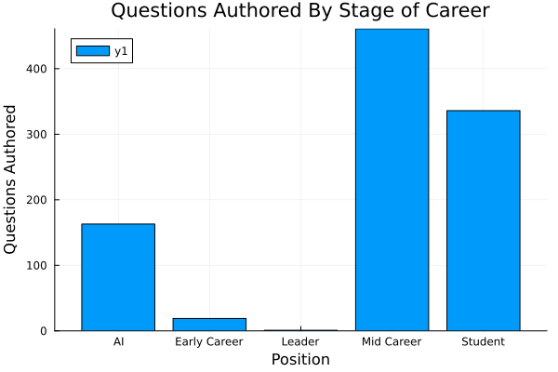
How Many Questions Did we Generate?
Between AI, Students, and Staff, we have generated about 980 questions so far in total.
In the same time, we have generated about 605 reviews
We have about 6 “Leaders” senior staff, we exclude them most of the time due to lack of data

Slide 20
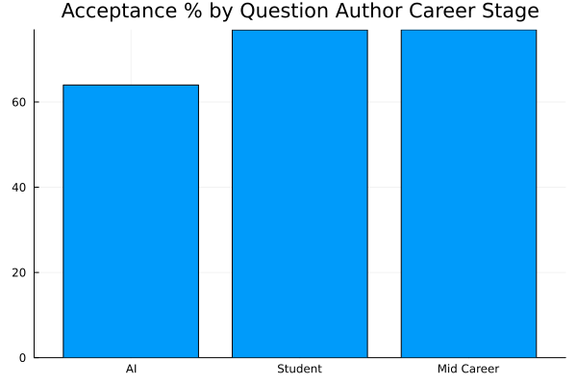
Does Author Stage of Career Matter for Question Quality?
Students and Staff produce questions that are accepted at roughly the same rate
AI generated questions tend to be accepted 14 %points less often.
There are possible improvements we could implement to the question generation method

Slide 21
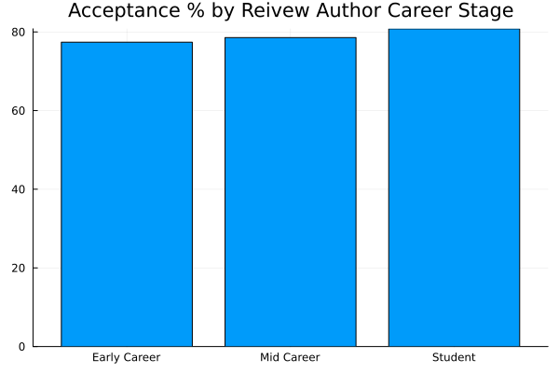
Does Reviewer Career Stage Effect Reviews?
Both Early Career, Mid Career Staff, and Students have very similar acceptance rates
This suggests our rubric is likely doing a good job
This also means we don’t have to always get senior folks to review, we can use students and junior staff.

Slide 22
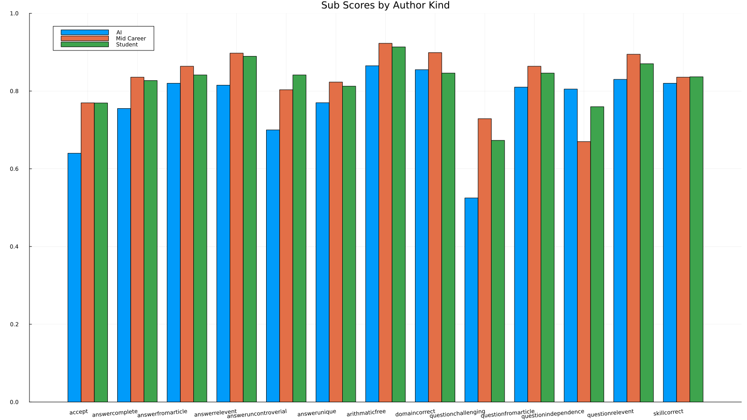
Detailed Score Breakdown
However, AI really struggles to make hard questions

Slide 23
Detailed Score Breakdown
Across the board, staff tend get higher quality scores to students, but similar acceptance

Slide 24
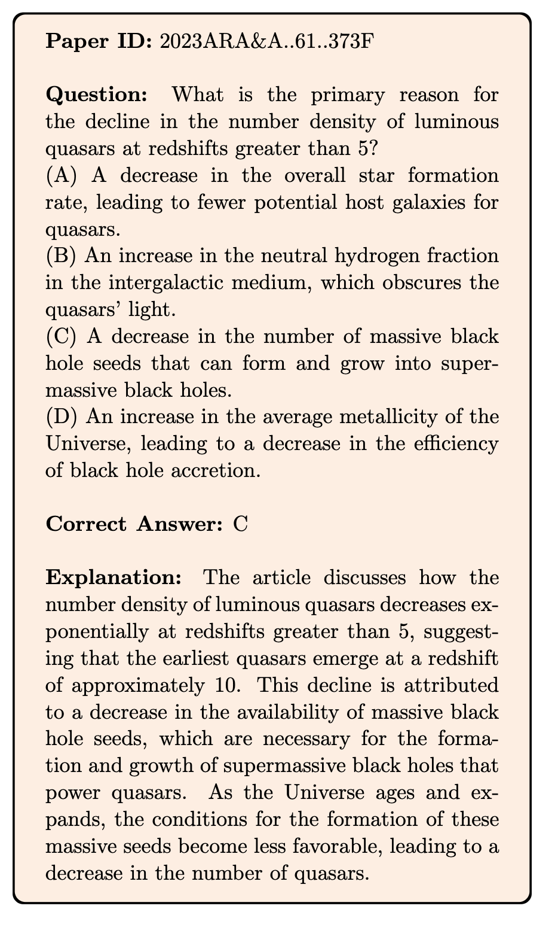
HOW DO WE WANT TO EVALUATE?
How to generate Multiple Choice Questions
Fully automatically (our work)
Collected 885 articles in Annual Review of Astronomy and Astrophysics, 1963 to 2023.
Used the Nougat optical character recognition (OCR) tool (Blecher et al. 2023) to transcribe these papers into text.
Fed each paper into Gemini-1.5-Pro and instructed it to propose 5 questions that can be answered based on the paper’s content.
Each question was accompanied by four options (A, B, C, D) only one of which is correct.
Robustness considerations added to the prompt generating the questions
Ting et al. (2024). Who Wins Astronomy Jeopardy
Notes:
Use Gemini 1.5 Pro to generate questions and answers based on this prompt
Iterate a few times with the instructions. Important to note that Gemini tends to make the correct answer the longest, so need to be explicit about equal lengths.
Also important to expand any acronym, and not refer to the original article because the questions are intended to be asked independently.
We prompted the model with three important instructions: (1) make the question specific enough to the article’s content but general enough so that it can later be asked independently; (2) also make the an- swer general enough, e.g., by refraining from pointing to specific sections of the article; and (3) ensure that the four answers are about the same in length, which stems from our earlier review that the model tends to pro- pose the correct answer to be the longest. Additionally, the model was tasked with providing an explanation and cited paragraphs from the review supporting the answer.

Slide 25
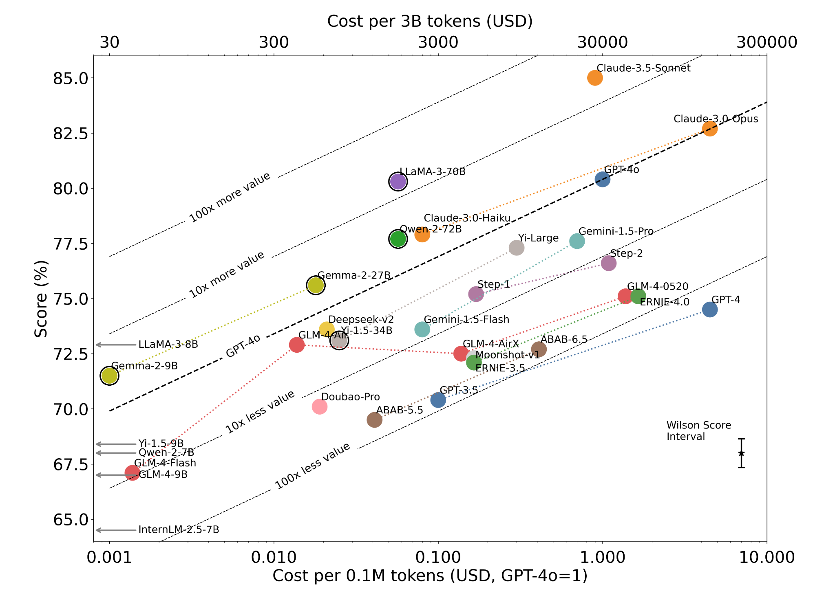
ASTRO BENCHMARK
Evaluation on N = 4,425 MCQs
x-axis show the cost per 0.1 million tokens
y-axis shows performance
Generally, within a series, there’s a 10-fold cost increase for a 3.5-point accuracy improvement
Claude-3.5-Sonnet outperforms others models.
LLaMA-3-70B is the only model in the same tier, albeit with lower performance.
Inference cost vs. performance
Notes:
Cost and performance trade-off in astronomical Q&A.
The dual x-axes show the cost per 0.1 million tokens and the cost to process an ArXiv astro-ph worth of tokens (∼3B tokens).
We use the average of input and output token costs based on June 2024 prices
Models with an outer circle indicate open- weights models run on low-cost APIs, leveraging recent specialized GPU developments for transformers.
Left arrows indicate cheaper open-weights models below the plot’s lower bound.
Models with an outer circle indicate open- weights models run on low-cost APIs, leveraging recent specialized GPU developments for transformers. Left arrows indicate cheaper open-weights models below the plot’s lower bound. Dotted lines of the same color connect models of the same series. Generally, within a series, there’s a 10-fold cost increase for a 3.5-point accuracy improvement
Dotted lines of the same color connect models of the same series. Generally, within a series, there’s a 10-fold cost increase for a 3.5-point accuracy improvement
Models with an outer circle indicate open- weights models run on low-cost APIs, leveraging recent specialized GPU developments for transformers. Left arrows indicate cheaper open-weights models below the plot’s lower bound. Dotted lines of the same color connect models of the same series. Generally, within a series, there’s a 10-fold cost increase for a 3.5-point accuracy improvement

Slide 26
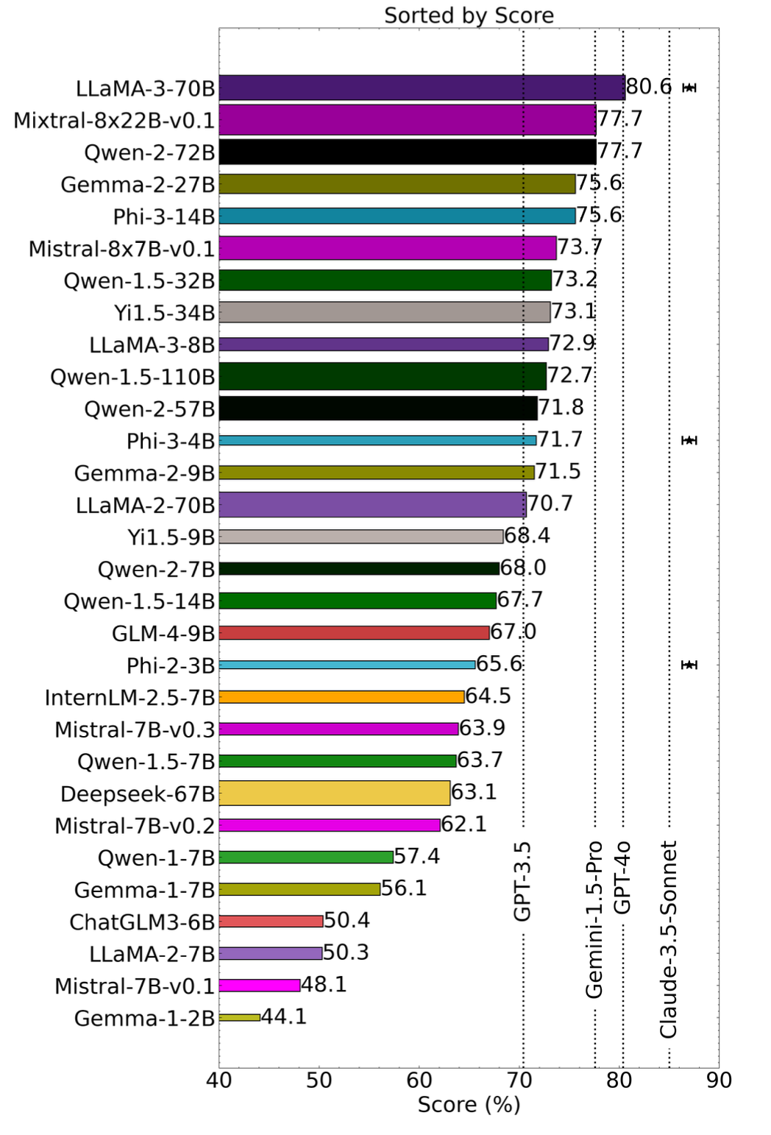
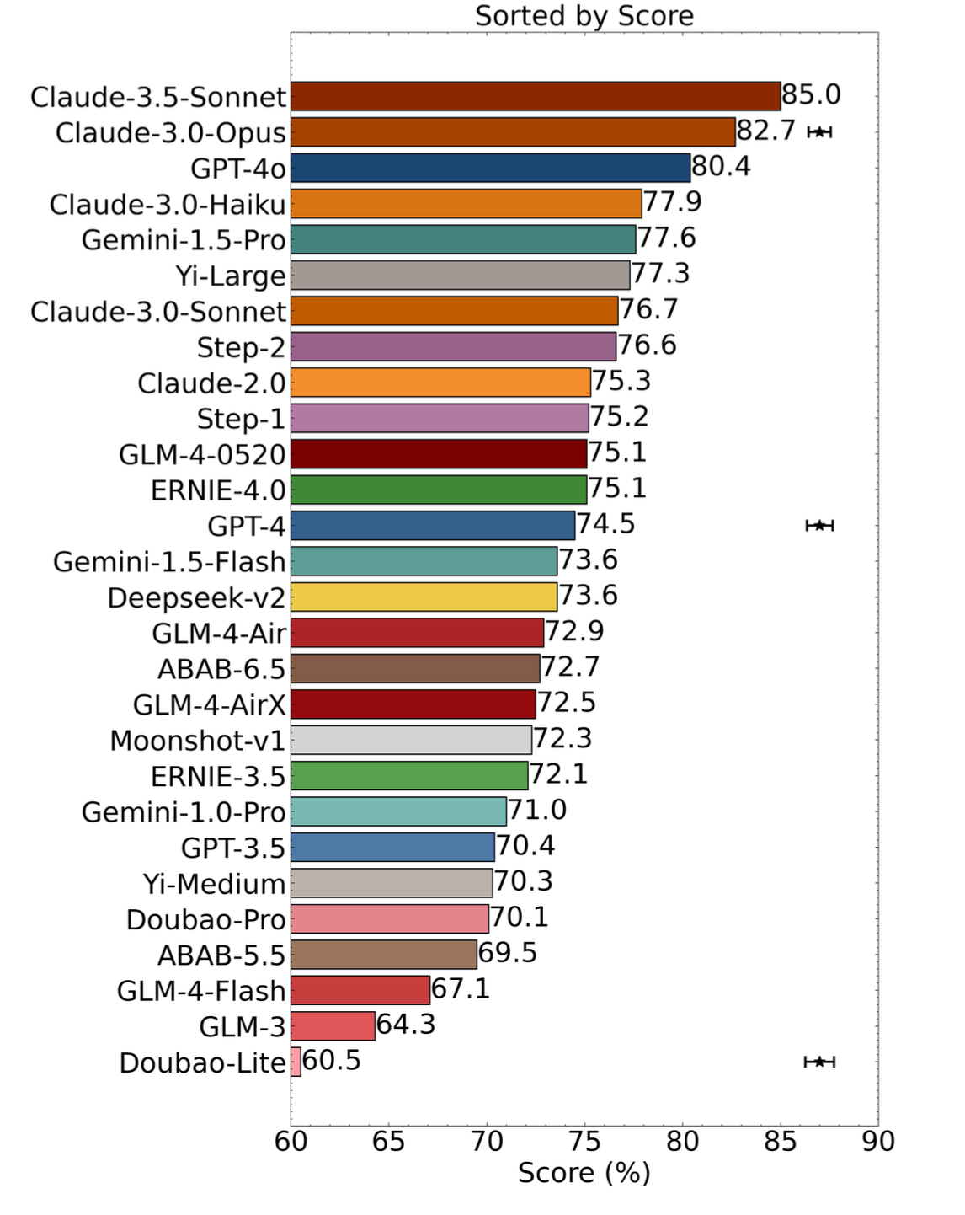
ASTRO BENCHMARK
4.6
Open source models in the 70B and above competitive for astronomical Q&A
Sub-areas in astrophysics
Notes:
Interestingly, while many cutting-edge models perform similarly in general benchmarks, they show significant variability in this niche astronomical research question-answering task
Claude-3.5-Sonnet performs best with an 85.0% accuracy, outperforming the closest non-Anthropic competitor, GPT-4o, by 4.6 percentage points.
LLaMA-3-70B performs best with an 80.6% accuracy, outperforming even GPT-4o (80.4%) and Gemini-1.5-Pro (77.6%), although it is still worse than Claude-3.5-Sonnet (85.0%).
Qwen-2-72B and Mixtral-8x22B-v0.1 are also competitive with 77.7% accuracy, which is on par with Gemini-1.5-Pro.
This shows that open-weights models, at least those with 70 billion parameters or more, are competitive in terms of astronomical Q&A performance.

Slide 27
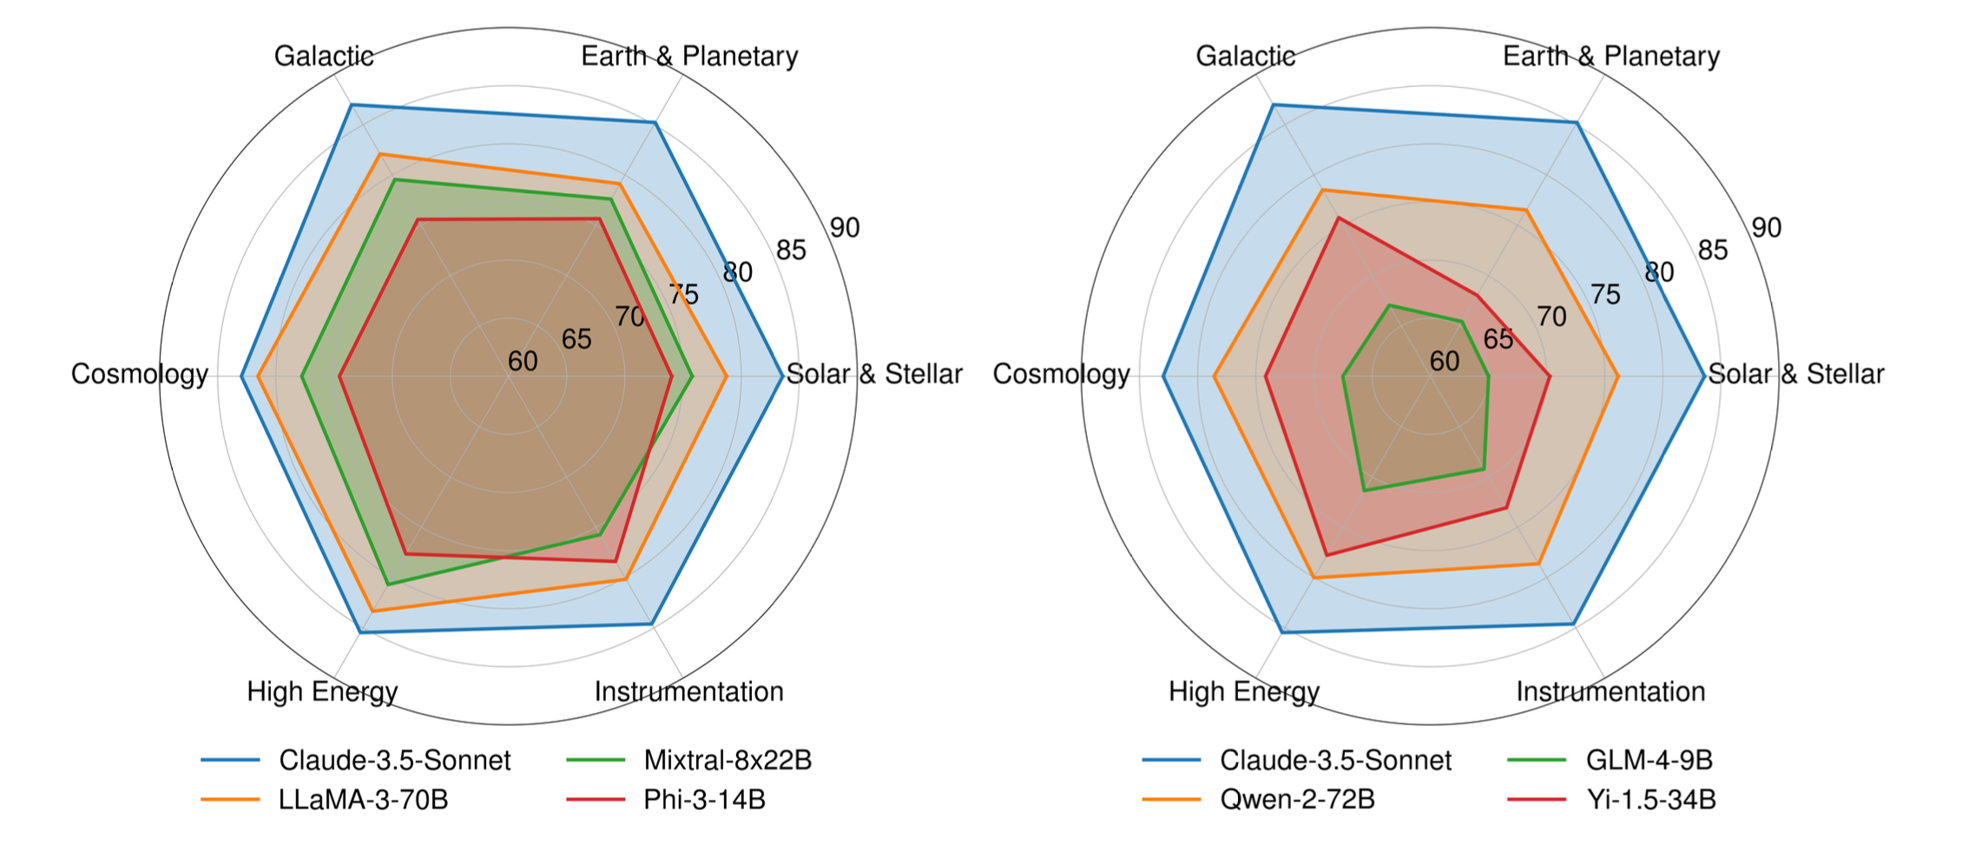
ASTRO BENCHMARK
Sub-areas in astrophysics
performance degradation in more recent topics
English-focused models
Non-English-focused models

